Slide 1
TensorFlow and Keras
Wen-Cheng Lin
Department of Medical Informatics, Tzu Chi University

Slide 2
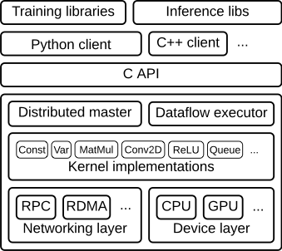
TensorFlow
An end-to-end open source machine learning platform
Open source library to help you develop and train ML models

Slide 3
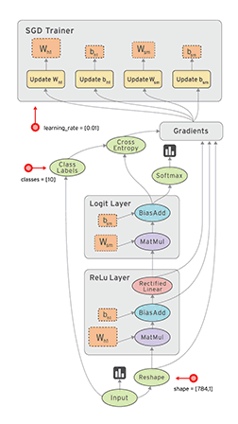
Client:
  Defines the computation as a dataflow graph.
    Dataflow graph: Represent computation in terms of the dependencies between individual operations.
  Initiates graph execution using a session.

Slide 4
Distributed Master
  Prunes a specific subgraph from the graph, as defined by the arguments to Session.run().
  Partitions the subgraph into multiple pieces that run in different processes and devices.
  Distributes the graph pieces to worker services.
  Initiates graph piece execution by worker services.
Worker Services (one for each task)
  Schedule the execution of graph operations using kernel implementations appropriate to the available hardware (CPUs, GPUs, etc).
  Send and receive operation results to and from other worker services.
Kernel Implementations
  Perform the computation for individual graph operations.

Slide 5
A tensor is a generalization of vectors and matrices to potentially higher dimensions.
  Internally, TensorFlow represents tensors as n-dimensional arrays of base datatypes.
A tf.Tensor has the following properties:
  a data type (float32, int32, or string, for example)
  a shape
    the number of dimensions (rank) and the size of each dimension
Rank | Math entity
0 | Scalar (magnitude only)
1 | Vector (magnitude and direction)
2 | Matrix (table of numbers)
3 | 3-Tensor (cube of numbers)
n | n-Tensor (you get the idea)

Slide 6
Keras
Keras is a high-level API to build and train deep learning models.
Keras is written in Python and capable of running on top of TensorFlow, CNTK, or Theano.
Focus on enabling fast experimentation.
  User friendliness, modularity, easy extensibility
The core data structure of Keras is a model, a way to organize layers.
  The simplest type of model is the Sequential model, a linear stack of layers.

Slide 7
Build a sequential model
  Combine standalone modules to create new models
# import tensorflow as tf
# from tensorflow import keras
# from tensorflow.keras import layers
from tensorflow.keras.models import Sequential
from tensorflow.keras.layers import Dense
model = Sequential()
model.add(Dense(units=64, activation='relu', input_shape=(100,)))
model.add(Dense(units=10, activation='softmax'))

Slide 8
Install Anaconda with Python
Anaconda
  Python Data Science Platform
  https://www.anaconda.com/distribution/
  Python 3.8 version, 64-Bit Graphical Installer
Create new virtual environment in Anaconda
  Open Anaconda Navigator
  click the Environments tab, then click the Create button.
    Name: tensorflow
    Packages: Python 3.7
  https://docs.anaconda.com/anaconda/navigator/getting-started/

Slide 9
Install Tensorflow, Keras, Pandas, matplotlib, and Scikit-learn in Anaconda
  Open Anaconda Navigator
Click the Environments tab, select a virtual environment (tensorflow)
Change package display options to “All”
Find and check Tensorflow, Keras, NumPy, Pandas, matplotlib, and Scikit-learn
click the bottom “Apply” button

Slide 10
NumPy: a fundamental package for scientific computing with Python. Arry processing for numbers, string, records, and objects.
Pandas: high-performance, easy-to-use data structures and data analysis tools for Python. Provide fast and efficient DataFrame object for data manipulation with integrated indexing.
Matplotlib: a Python 2D plotting library which produces publication quality figures.
Scikit-learn: a library for machine learning algorithms.

Slide 11
Install Jupyter Notebook in Anaconda
  Open Anaconda Navigator
Click the Home tab
Select a virtual environment (tensorflow) in “Applications on” items
Find Jupyter Notebook, click Install button

Slide 12
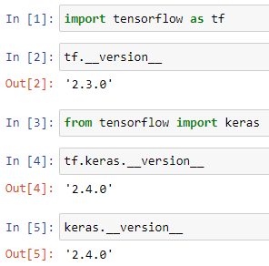
Run Jupyter Notebook
Run Anaconda prompt (tensorflow)
Chang directory to working directory (>cd path)
Type “jupyter notebook” then Enter
Create a new notebook
  https://nbviewer.jupyter.org/github/jupyter/notebook/blob/master/docs/source/examples/Notebook/Notebook%20Basics.ipynb

Slide 13
Install Tensorflow-gpu
Install Cuda
  The NVIDIA® CUDA® Toolkit provides a development environment for creating high performance GPU-accelerated applications.
  https://developer.nvidia.com/cuda-downloads
Install cuDNN
  The NVIDIA CUDA® Deep Neural Network library (cuDNN) is a GPU-accelerated library of primitives for deep neural networks
  https://developer.nvidia.com/cudnn
  Extract downloaded file
  Add the path of “%cudnn%\cuda\bin” into PATH environment variable
or install Cuda Toolkit and cuDNN in Anaconda virtual environment
Install Tensorflow-gpu and Keras in Anaconda virtual enviroment

Slide 14
Multilayer Perceptron

Slide 15

Mnist Handwritten Digits Dataset
Modified National Institute of Standards and Technology database of handwritten digits
60,000 training images and 10,000 testing images

Slide 16
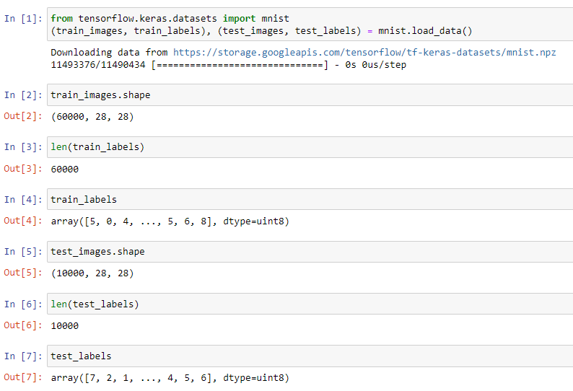
Load Mnist dataset in Keras
mnist.load_data()
  Store dataset in diratory %user%\.keras\
  If dataset is already exist, will not download again
Dimensions of training data
Number of training data
Labels of training data

Slide 17
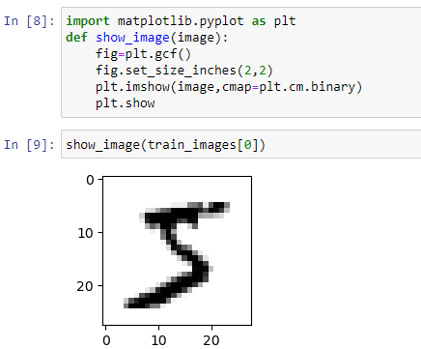
Before import, check is matplot package installed in Anaconda environment
Get the current figure.
Set the size of image to show
Display a image, cmap=plt.cm.binary setup colormap used to map scalar data to colors
Display a figure
Show the first image in train set

Slide 18
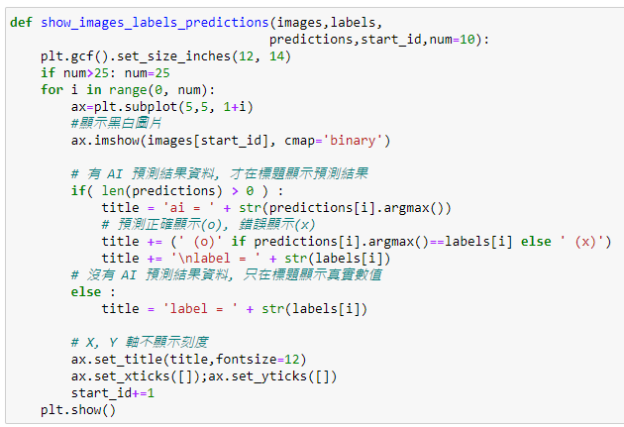
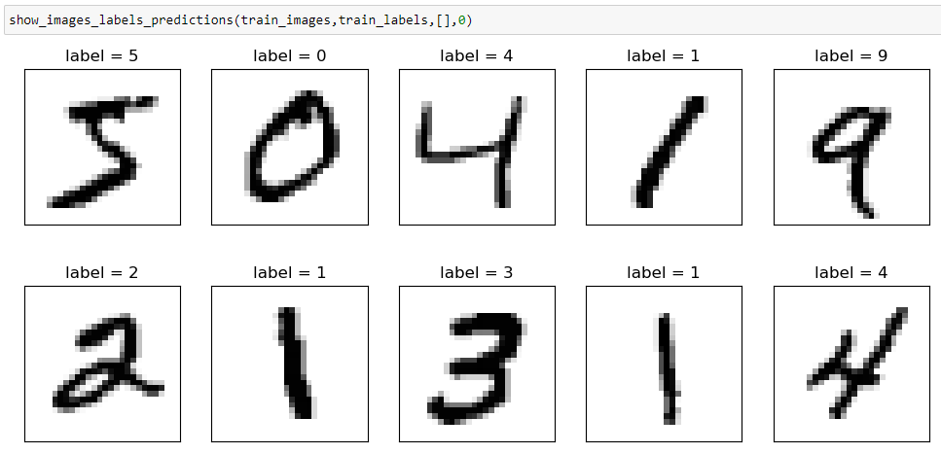

Slide 19
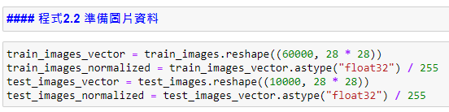
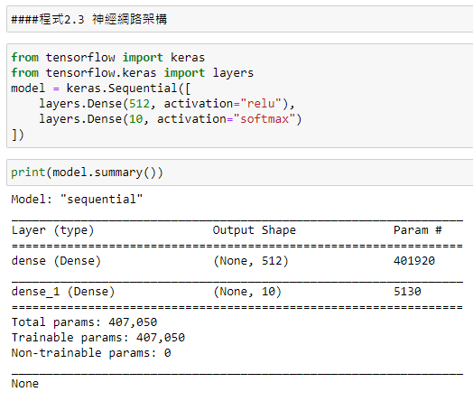
Data preprocessing, transform to the network input format
Transform 28x28 image features into 1D (784) vector
Since gray value is 0~255, thus feature values are normalized to 0~1
Dense layer: The nodes of adjacent layers are fully connected
784x512 + 512
512x10 + 10

Slide 20
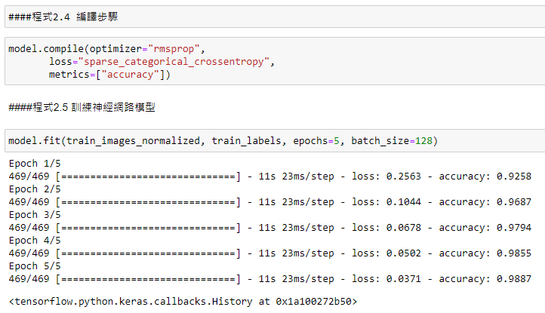
Configure the learning process
batch_size: Integer or None. Number of samples per gradient update. If unspecified, batch_size will default to 32.
epochs: Integer. Number of epochs to train the model. An epoch is an iteration over the entire x and y data provided.
verbose: 'auto', 0, 1, or 2. Verbosity mode. 0 = silent, 1 = progress bar, 2 = one line per epoch. 'auto' defaults to 1 for most cases, but 2 when used with ParameterServerStrategy.

Slide 21
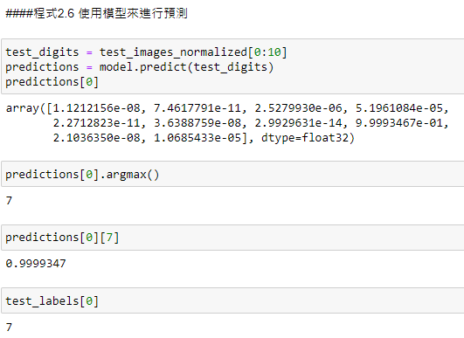
Predict the first 10 images in test data. Results are store in predictions
Predictions[0] stores the probabilities of the first image test_digits[0] belonging to each class.
The index of the maximum value in Predictions[0].
The maximum value is 0.9999347 (Predictions[0][7]).

Slide 22
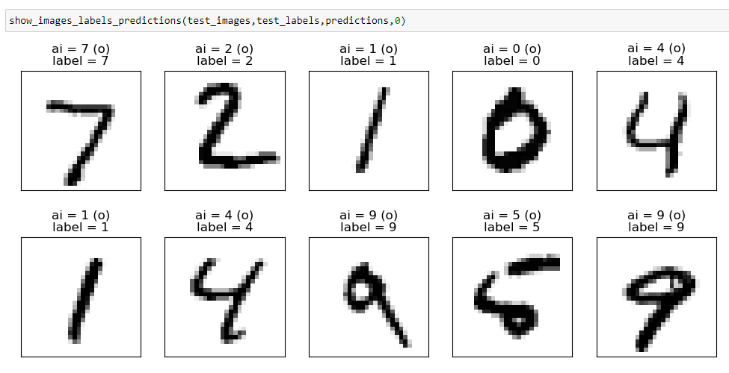

Slide 23
Exercise 1
Build a MLP with two hidden layers to recognize handwritten digits (Mnist dataset)
Compare the performance of MLP with two hidden layers to MLP with one hidden layer

Slide 24
Titanic Dataset
Predict which passengers in Titanic survived
pclass | survived | name | sex | age | sibsp | parch | ticket | fare | cabin | embarked | boat | body | home.dest
1 | 1 | Allen, Miss. Elisabeth Walton | female | 29 | 0 | 0 | 24160 | 211.3375 | B5 | S | 2 |  | St Louis, MO
1 | 1 | Allison, Master. Hudson Trevor | male | 0.9167 | 1 | 2 | 113781 | 151.5500 | C22 C26 | S | 11 |  | Montreal, PQ / Chesterville, ON
Survival
0 = No,
1 = Yes
<Target>
# Parents & childen Aboard
# Siblings Aboard
Port of Embarkation
C = Cherbourg,
Q = Queenstown,
S = Southampton
Ticket class
1 = 1st,
2 = 2nd,
3 = 3rd

Slide 25
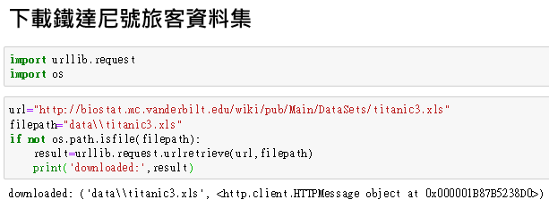
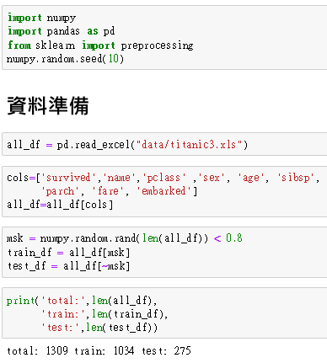
urllib: a package that collects several modules for working with URLs
urllib.request for opening and reading URLs
os: using operating system dependent functionality
Copy a network object denoted by a URL to a local file
Read an Excel file into a pandas DataFrame (need xlrd package)
DataFrame: Two-dimensional size-mutable, potentially heterogeneous tabular data structure with labeled axes (rows and columns)
Select columns and store back to dataframe
randomly generates len(all_df) numbers from the uniform (0, 1) distribution.
msk is a boolean array, where msk[i] is True if the i-th value randomly generated by np.random.rand is less than 0.8.
Splite data into train and test data (8:2)

Slide 26
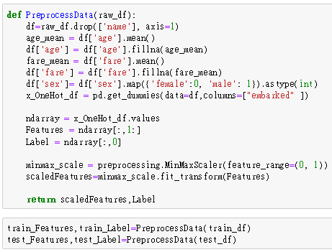
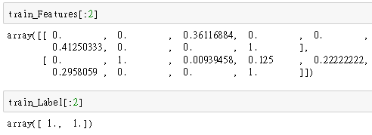
Remove column “name”. axis=1 indicates column.
Compute mean value of all data in column “age”
Fill the value age_mean into the cell with NA/NaN value in column “age”
Change the values in column “sex” into 0 if the value is “female” or 1 if the value is “male”
Convert categorical variable (column “embarked”) into dummy/indicator variables, i.e. one hot encoding.
Convert DataFrame into array.
ndarray[:, 0] select all records with column 0. ndarray[ : , 1: ] select all records with column 1 to last column.
Transforms features by scaling each feature to a given range.
.fit_transform() fits transformer to data, then transform it.

Slide 27
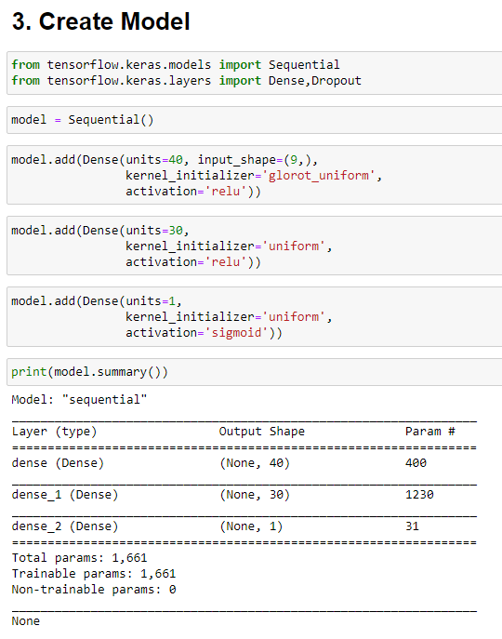
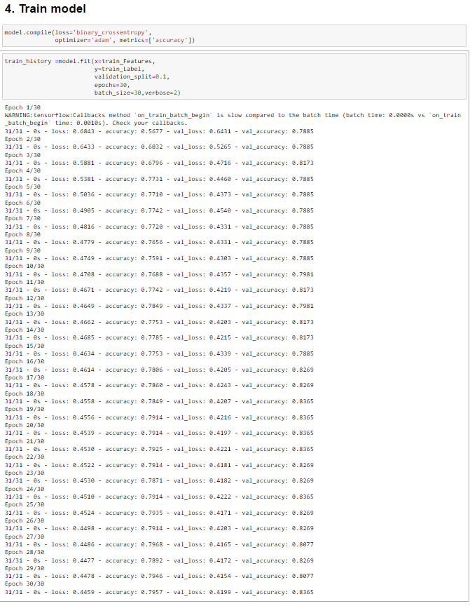
validation_split: Float between 0 and 1. Fraction of the training data to be used as validation data. The model will set apart this fraction of the training data, will not train on it, and will evaluate the loss and any model metrics on this data at the end of each epoch. The validation data is selected from the last samples in the x and y data provided, before shuffling.

Slide 28
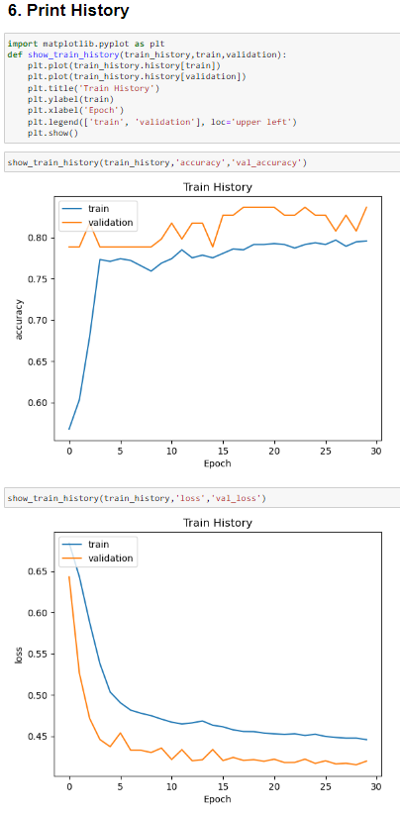
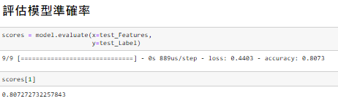
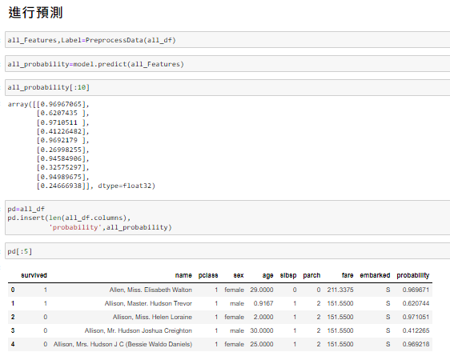
Predict test data. Sigmoid unit → 0~1
Insert column into DataFrame at specified location

